Slide 1
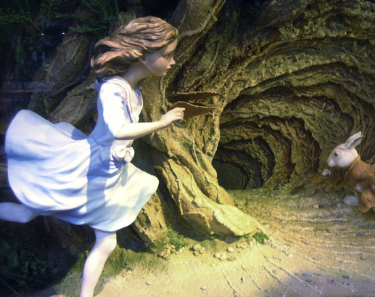
Let’s process some data!

Slide 2

Review
What function do we use to load a csv file?
What is the structure of ggplot2?
read_csv()
data, mapping, geometries

Slide 3
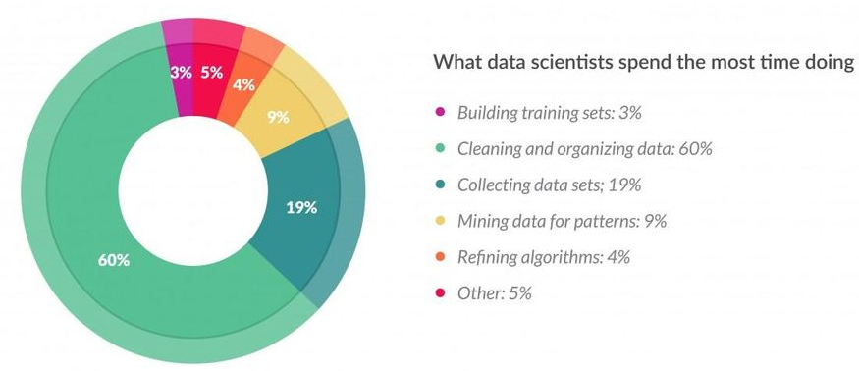
~80% of time “munging” data

Slide 4
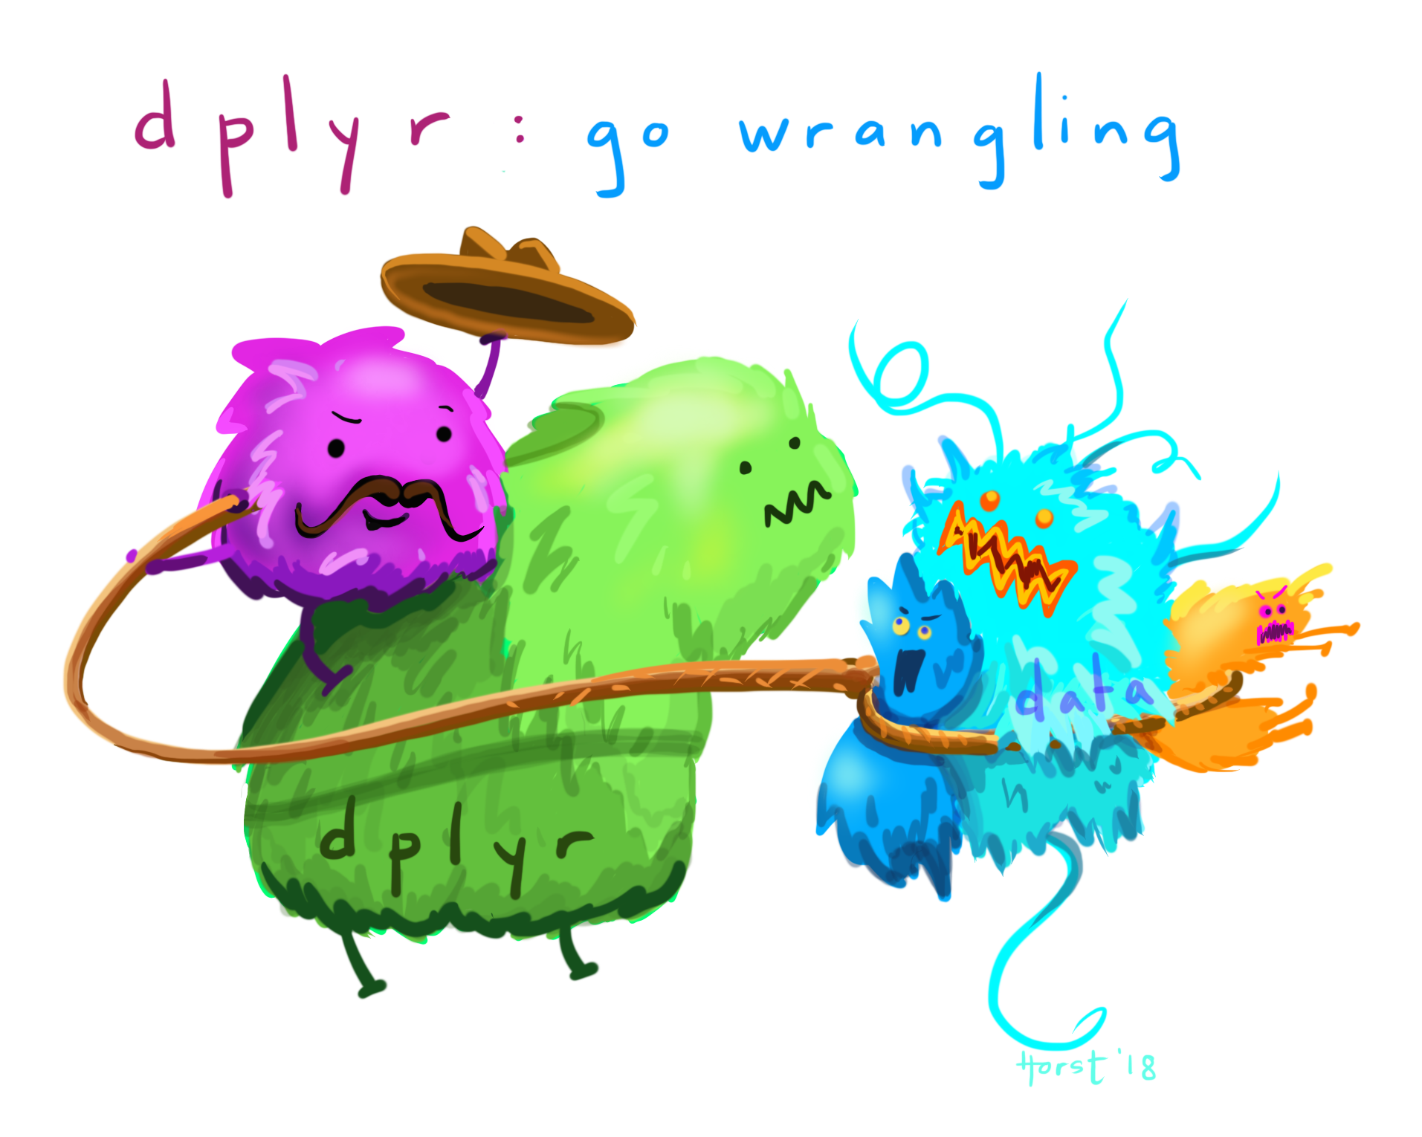

Slide 5
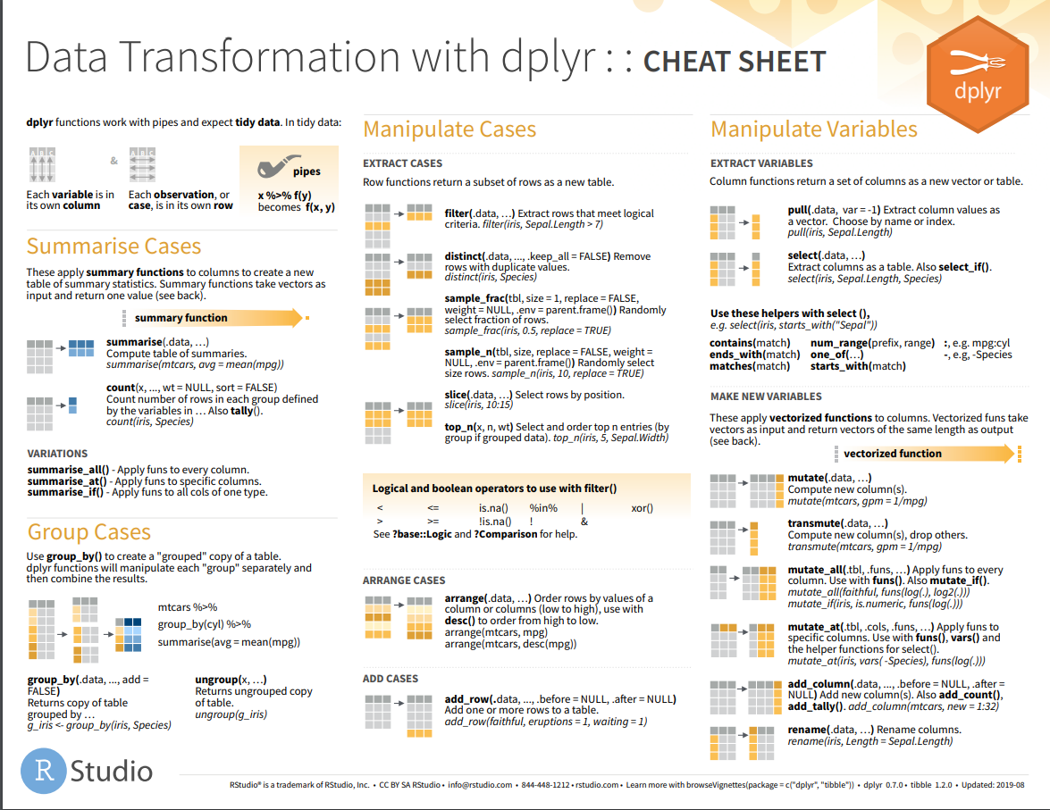

Slide 6


Slide 7

What we learned
Theory:
Light processing with dplyr
Practice:
filter
conditions and/or
select (including use of colon : )
unique
arrange
group_by
summarize
count

